Slide 1
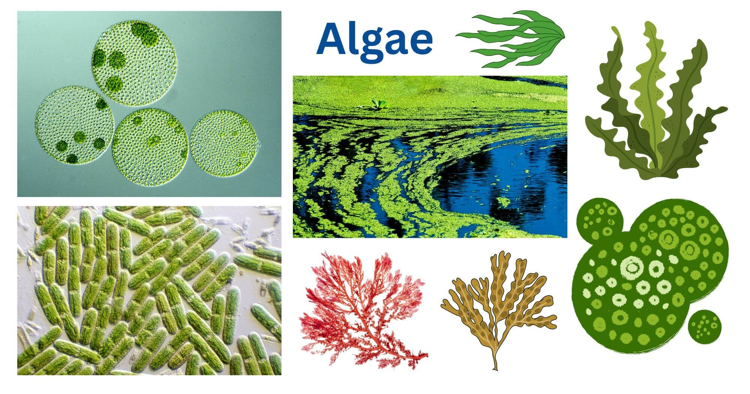
CLASSIFICATION OF ALGAE
Dr. Trilok Kumar
Assistant Professor
Govt. Digvijay Autonomous PG College, Rajnandgaon, C.G.

Slide 2
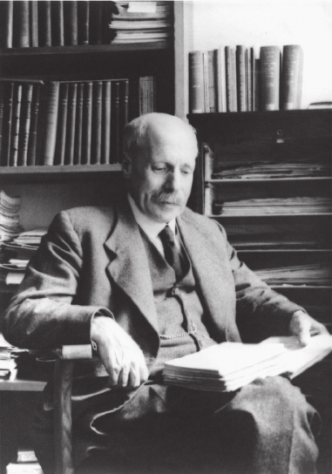
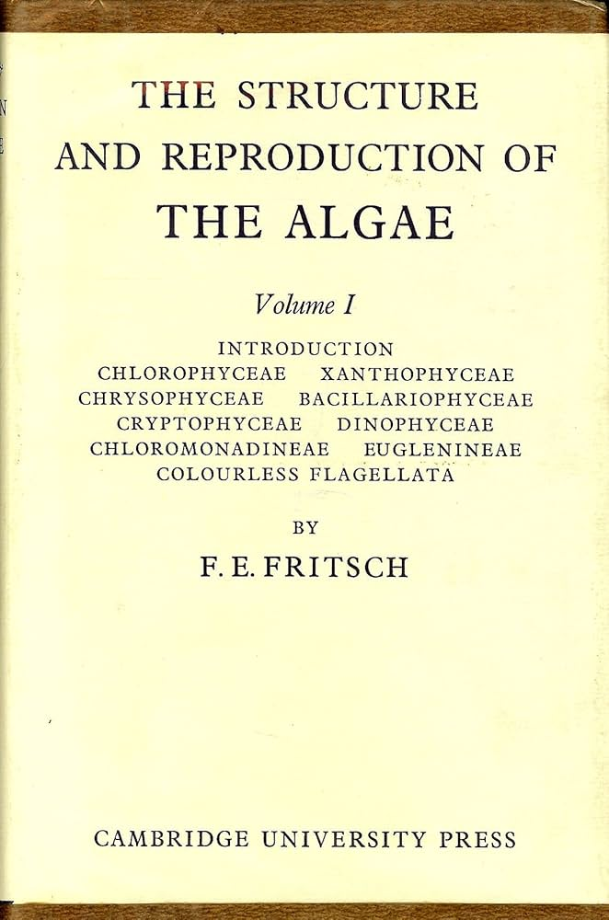
(A) Classification of F.E. Fritsch (1935)
F.E. Fritsch wrote book:
“The Structure and Reproduction of the Algae”
F.E. Fritsch (1935) proposed classification of algae on basis of following characters:
Pigmentation
Reserve food material
Type of flagella
He classified algae into 11 classes.

Slide 3
Name of Classes of Algae on basis of Pigmentation, Reserve food material & Flagella (11 Classes according to F.E. Fritsch 1935)
CLASS | Common name | CHLOROPHYLL | CAROTENES | XANTHOPHYLL | Phycobilins | RFM | FLAGELLA | e.g.
1. Chlorophyceae | Green algae | Chll-a, Chll b | B-Carotene, Y-Carotene | Lutein, Zeaxanthin, Neoxanthin, Astaxanthin | - | Stach | 2-8 Equal | Volvox, Spirogyra, Ulva etc.
2. Xanthophyceae | Yellow-green algae | Chll-a, Chll-e | B-Carotene | Violaxanthin, Neoxanthin | - | Chrysolaminarin, Leucosin& Oil | 2 Unequal | Vaucheria, Botrydium etc.
3. Chrysophyceae | Golden-brown algae | Chll-a, Chll-c | B-Carotene | Lutein, Fucoxanthin, high conc. Of Phycochrysin | - | Chrysolaminarin, Leucosin& Oil | Absent, If present 2 Unequal | Dinobryon, Chrysosaccus etc.
4. Bacillariophyceae | Daitoms | Chll-a, Chll-c | B-Carotene | Fucoxanthin, Diataxanthin | - | Chrysolaminarin, Leucosin& Oil | Absent | Bacillaria, Pinnularia etc.
5. Cryptophyceae | Brown-orange algae | Chll-a, Chll-c | - | - | Phycoerythrin, Phycocyanin | Starch | 2 Unequal | Cryptomonas, Chroomonas etc.
6. Dinophyceae | Fire algae | Chll-a, Chll-C2 | B-Carotene | Peridinin | - | Starch, Oil & Dinosterol | 2 Equal | Ceratium, Peridinium, Gonyaulax( caused red tides, Noctiluca (Bioluminescent)
Carotenoids

Slide 4
CLASS | Common name | CHLOROPHYLL | CAROTENES | XANTHOPHYLL | Phycobilins | RFM | FLAGELLA | e.g.
7. Chloromonadineae | Raphidophytes/ Bright green algae | Chll-a, Chll b | - | High conc. Of Xanthophyyll | - | Oil | 2 Equal | Trentonia, Gonyostomum etc.
8. Euglenophyceae | Euglenoidae | Chll-a, Chll-b | B-Carotene | Astaxanthin, Diadinoxanthin | - | Carbohydrate- Paramylon or Paramylum (Polymer of B-1,3 glucan), Lipid | 2 Unequal | Euglena, Phacus, Peranema etc.
9. Phaeophyceae | Brown algae | Chll-a, Chll-c | B-Carotene | High conc. Of Fucoxanthin, | - | Chrysolaminarin, Leucosin& Oil | 2 Unequal | Ectocarpus, Fucus etc.
10. Rhodophyceae | Red algae | Chll-a, Chll-d | B-Carotene | Some Xanthophyll | High conc. Of r-Phycoerythrin, r-Phycocyanin | Floridian starch | Absent | Polysiphonia, Gracilaria etc.
11. Cyanophyceae/ Myxophyceae | Blue green algae (BGA)/ Cyanobacteria | Chll-a | B-Carotene | Lutein | High conc. Of c-Phycocyanin & c-Phycoerythrin | Cyanophycean Starch | Absent | Nostoc, Oscillatoria, Anabaena Spirulina etc.
Carotenoids

Slide 5
Smith’s Classification
G.S. Smith (1955) classified algae into 7 DIVISIONS and 13 Classes on basis of Phylogentic relationship:
Division 7 | 1. Chlorophyta | Class 13 | 1. Chlorophyceae
 |  |  | 2. Charophyceae
 | 2. Euglenophyta |  | 3. Euglenophyceae
 | 3. Pyrophyta |  | 4. Desmophyceae
 |  |  | 5. Dinophyceae
 | 4. Chrysophyta |  | 6. Chrysophyceae
 |  |  | 7. Xanthophyceae
 |  |  | 8. Bacillariophyceae
 | 5 Phaeophyta |  | 9. Isogeneratae
 |  |  | 10 Heterogeneratae
 |  |  | 11 Cyclosporae
 | 6 Cyanophyta |  | 12 Mysophyceae
 | 7. Rhodophyta |  | 13 Rhodophyceae

Slide 6
Alexopoulos & Bold’s Classification
Alexopoulos and Bold (1976) classified algae into 11 DIVISIONS, They added –phyco word in name of division:
Division 11 | Cyanophycophyta
 | 2. Chlorophycophyta
 | 3. Charophycophyta
 | 4. Euglenophycophyta
 | 5. Xanthophycophyta
 | 6. Chrysophycophyta
 | 7. Bacillariophycophyta
 | 8. Phaeophycophyta
 | 9. Pyrophycophyta
 | 10. Cryptophycophyta
 | 11. Rhodophycophyta

Slide 7
Modern Classification of Algae
Modern phycologist V.J. Chapman & D.J. Chapman (1973) have been classified algae on the basis of rules proposed by The International Code of Nomenclature for algae, fungi and Plant (ICNafp).
They have given the rank DIVISION to the 11 Classes proposed by F.E. Fritsch (1935) and classified them as follows:

Slide 8
Modern Classification of Algae
Division | Class | Order
1. Cyanophyta | 1. Cyanophyceae | Chlorococcales Chamisiphonales Oscillatoriales Nostocales Cytonimales Stigonimatales Rivulariales
2. Chlorophyta | 1. Prasinophyceae 2. Chlorophyceae | Pyramimonadales Halosphaerales 1. Volvocales 2. Chlorococcales 3. Ulothrichales 4. Oedogoniales 5. Chaetophorales 6. Siphonocladales 7. Dasycladales 8. Derbesiales 9. Siphonales 10. Dichotomosiphonales 11. Zygnematales 12. Charales

Slide 9
Division | Class | Order
3. Charophyta | Charophyceae | 1. Charales
4. Euglenophyta | Euglenophyceae | 1. Euglenales
5. Pyrrhophyta | Pyrrhophyceae | 1. Peridiniales
6. Xanthophyta | Xanthophyceae | Chloramoebales Rhizochloridales Heterogloeales Mischocaccales Trionematales Vaucheriales
7. Bacillariophyta | Bacillariophyceae | Pennales Centrales
8. Chrysophyta | Chrysophyceae | Chrysomonadales Rhizochrysidales Chrysocaples Chrysophaerales Phaeothamniales

Slide 10
Division | Class | Order
9. Cryptophyta | Cryptophyceae | Cryptomonadales Cryptococcales
10. Phaeophyta | 1. Isogeneratae | Ectocarpales Tilopteridales Sphacelariales Cutleriales Dictyotales
 | 2. Heterogeneratae | 1. Laminariales
 | 3. Cyclosporae | 1. Fucales
11. Rhodophyta | Rhodophyceae | Bangiales Nemalionales Ceramiales

